Slide 1
IoT Dashboard
Mubeen Khan and Damiano Visalli
Final Project Presentation

Slide 2
Agenda
Project introduction
Dashboard and Project Wiring
Dashboard Design
Members Roles for each phase
Activities for each Phase
Challenges and achievements

Slide 3
Project introduction
The goal of this project is to build and design a web-based IoT dashboard.
The system is built using different technologies and devices we have learned in this course and implement them in one single system.
We utilized what we learned in this course to build an application that will capture data and make decisions based on the data.

Slide 4
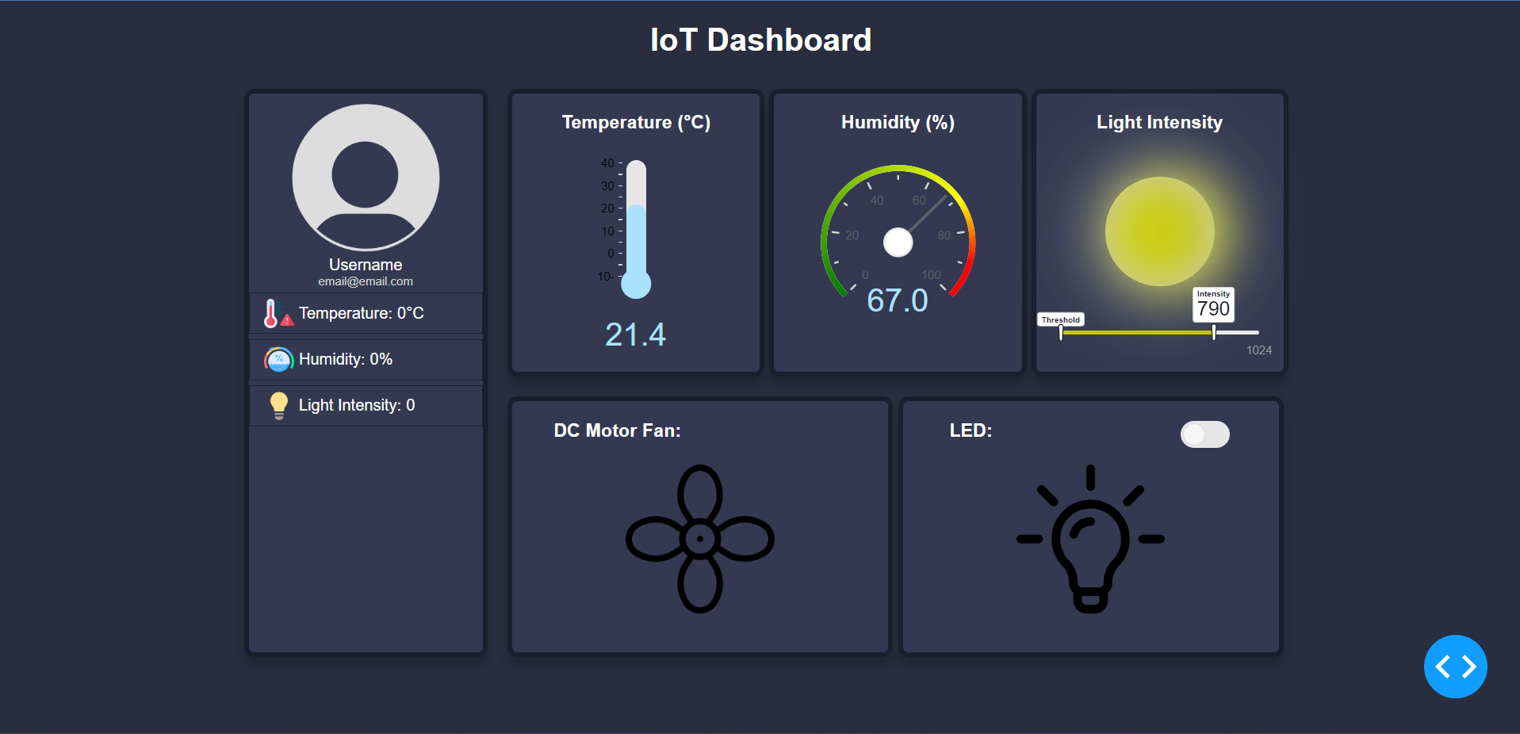
Dashboard

Slide 5
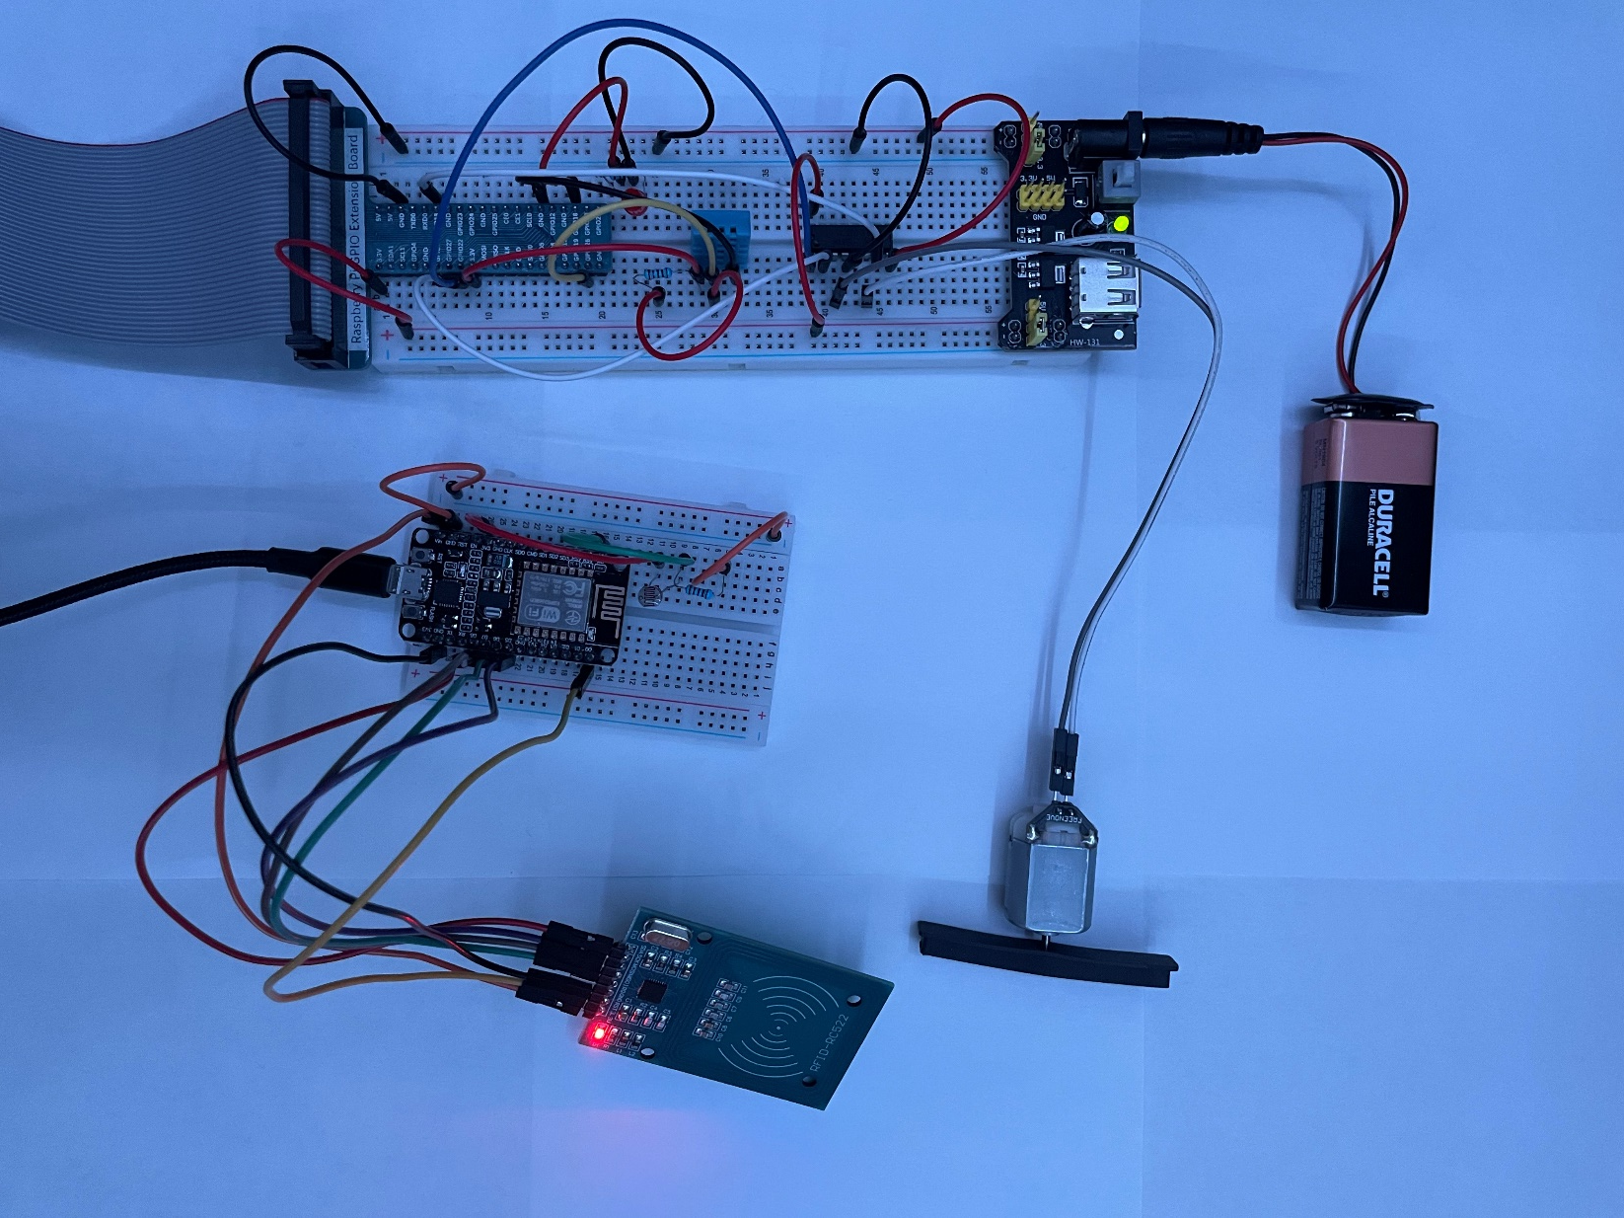
Project Wiring

Slide 6
Dashboard Design
Color Pallet:
Inspired by the themes in VScode
Palenight Theme
Layout:
The top side displays all the data captured from the sensors
The bottom side represent the hardware’s that can be manipulated using the sensors data (DC motor and LED)
Left side has the user information and thresholds.

Slide 7
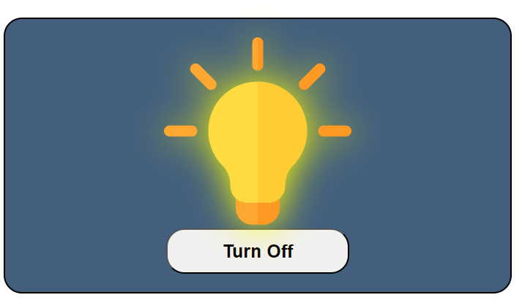
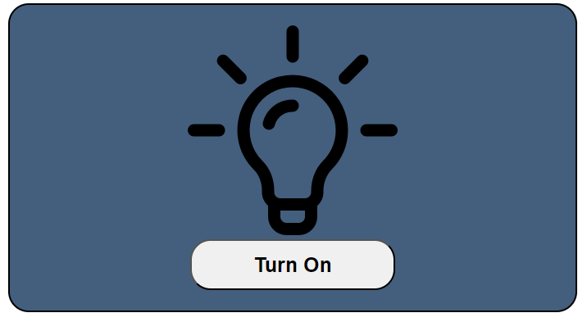
Member roles: Phase 1
Mubeen:
Did all of phase 1, because it was a short and simple task.
Main objective was to understand how Dash works and how each feature will call its method using a callback.

Slide 8
Member roles: Phase 2
Mubeen:
Worked on sending and reading emails
Reading DHT11 temperature and humidity data
Displaying DHT11 data on dashboard
CSS for dashboard
Worked on Motor wiring
Worked on turning motor on and off

Slide 9
Member roles: Phase 3
Mubeen:
Retrieve light intensity from the Photoresistor using ESP8266
Publish data to the broker on Arduino
Subscribe to broker using the topic on python
CSS for dashboard
Send data retrieved from the ESP8266 to the app
Display and update data on the dashboard

Slide 10
Member roles: Phase 4
Mubeen:
Read data from RFID tag and publish it to the broker on Arduino
Subscribe to broker using the topic on python
While also subscribing to the Photoresistor topic from phase 3
Created the SQLite database
Sending email to the user when they Tap the RFID tag on the RDIF reader
Damiano:
Used RFID tag ID to retrieve user information from database
Display the user's data on the dashboard

Slide 11
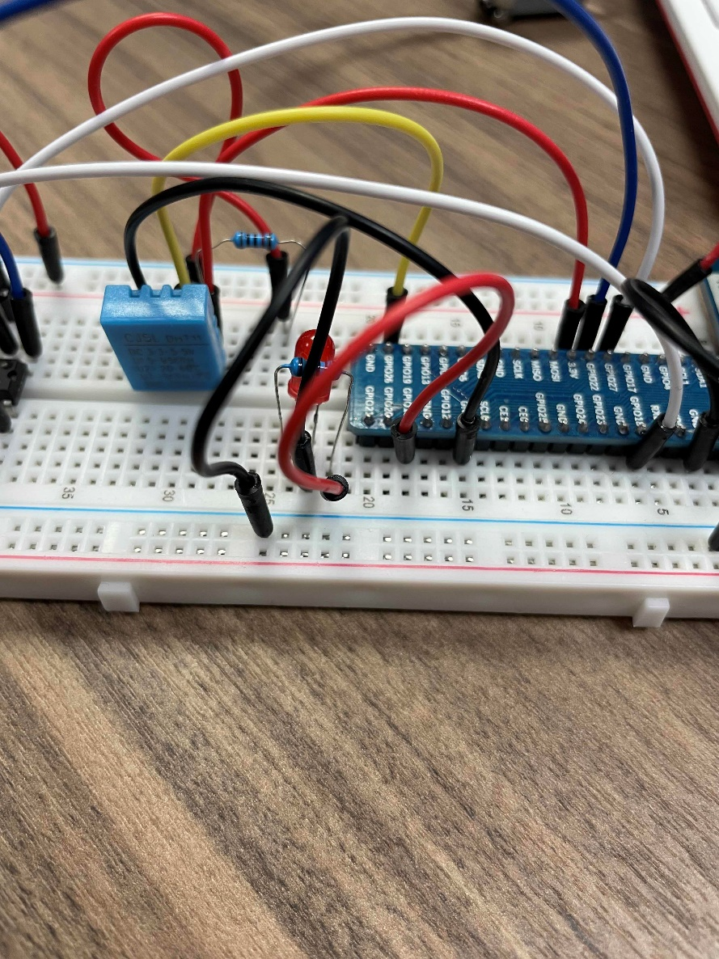
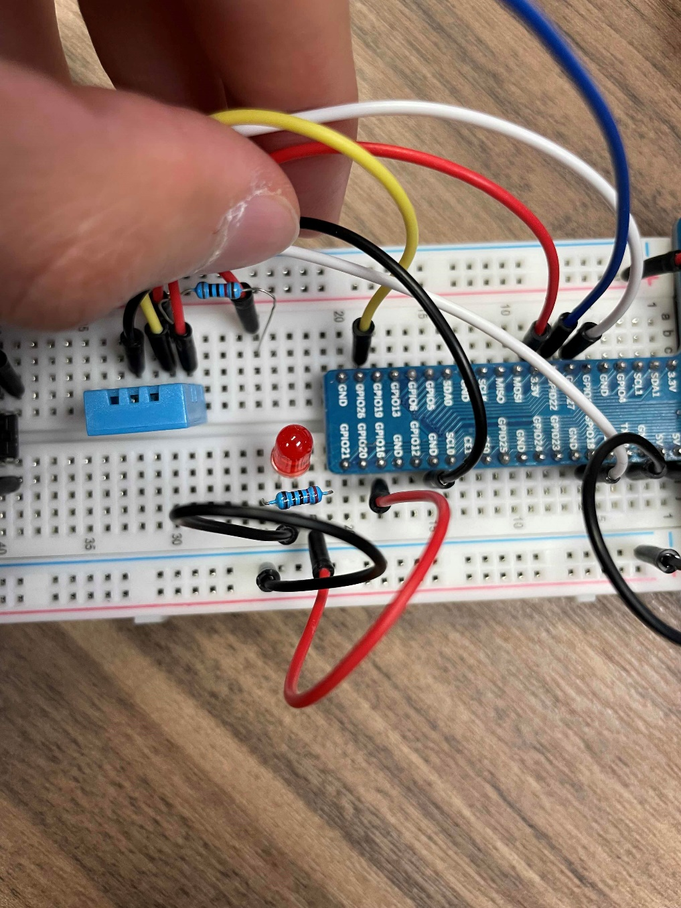
Activities for Phase 1
In Phase 1, we implemented a switch/button on the dashboard that turn an LED on and off on both the dashboard and the breadboard.

Slide 12
Activities for Phase 1 (Components and Libraries)
Components used:
Libraries imported:
LED
Resistor (220Ω)
Wires
Breadboard
Raspberry-Pi
Dash
RPI.GPIO

Slide 13
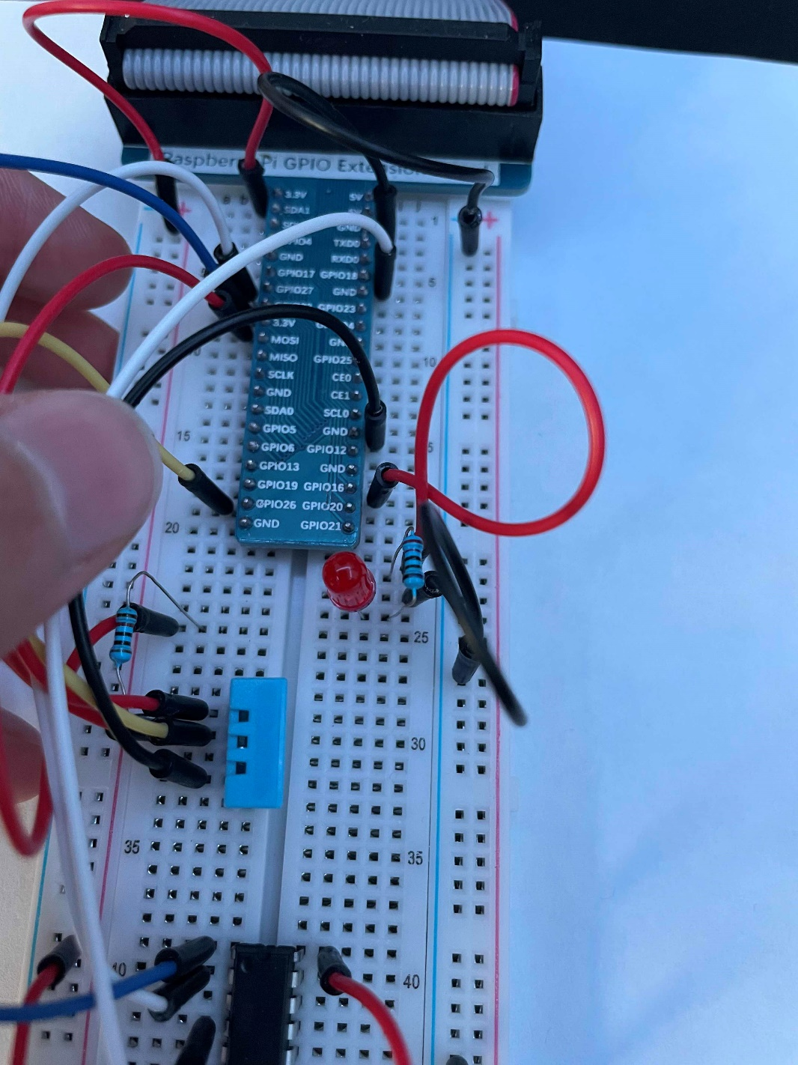
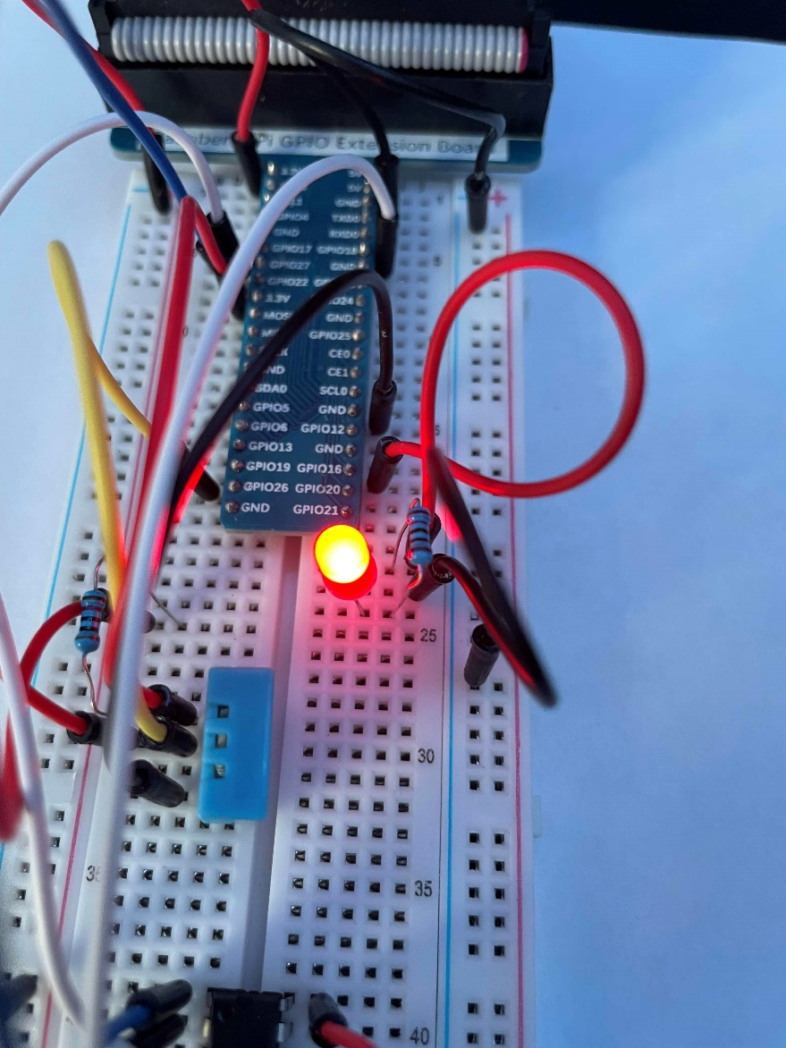
Activities for Phase 1 (Breadboard)
When the switch/button on the dashboard is turned on, the LED on the breadboard will turn on.
When the switch/button is off, the LED on the breadboard will turn off.

Slide 14
Activities for Phase 1 (Dashboard)
When the switch/button is on, the image on the dashboard will change to an image that represents an ON LED.
When the switch/button is off, the image on the dashboard will change to an image that represents an OFF LED.

Slide 15
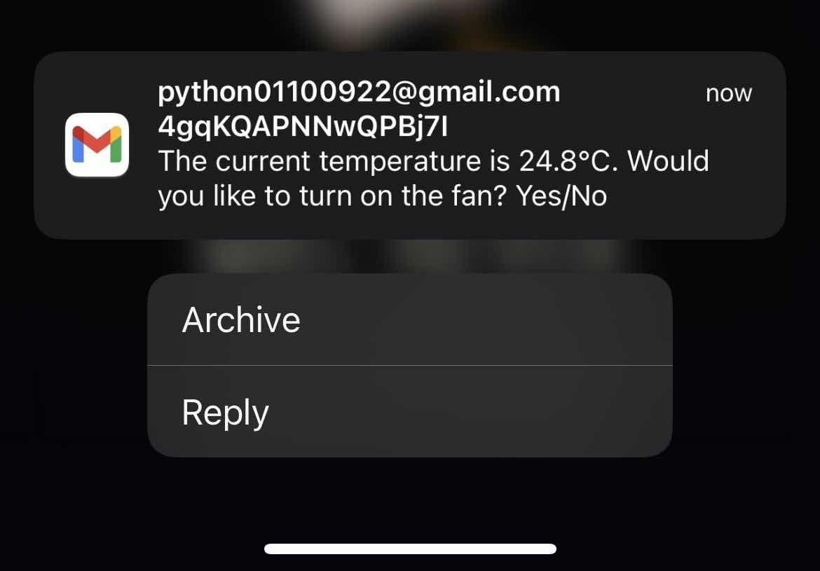
Activities for Phase 2
In Phase 2, we captured the Temperature and Humidity data from the DHT11 sensor and displayed it on the dashboard.
When the temperature surpasses the threshold, the system will send an email to the user asking whether they want to turn the fan/motor ON.
If the user replies with anything other than “yes” or they don’t reply at all, the fan/motor will remain OFF

Slide 16
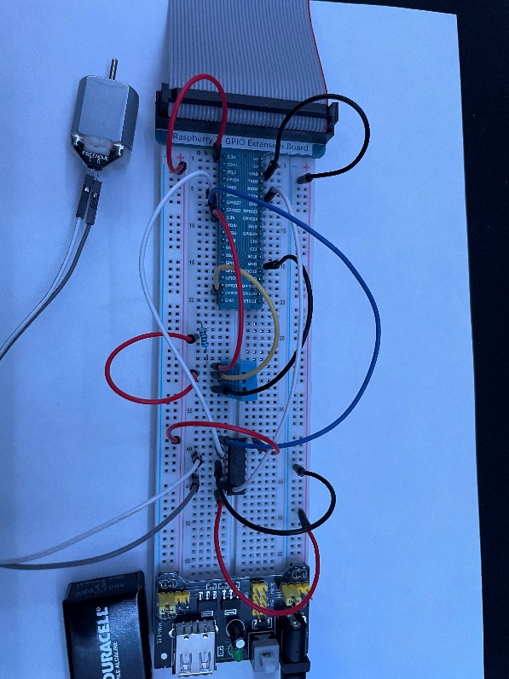
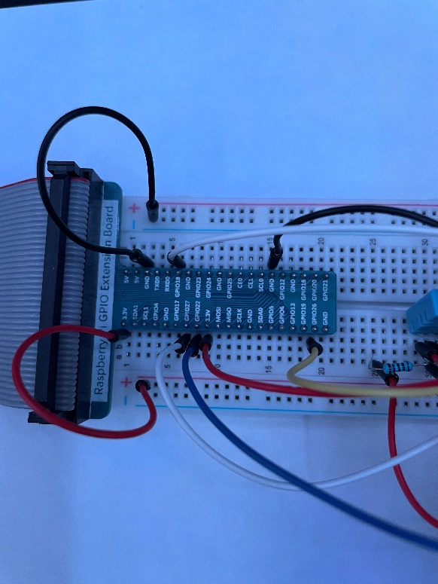
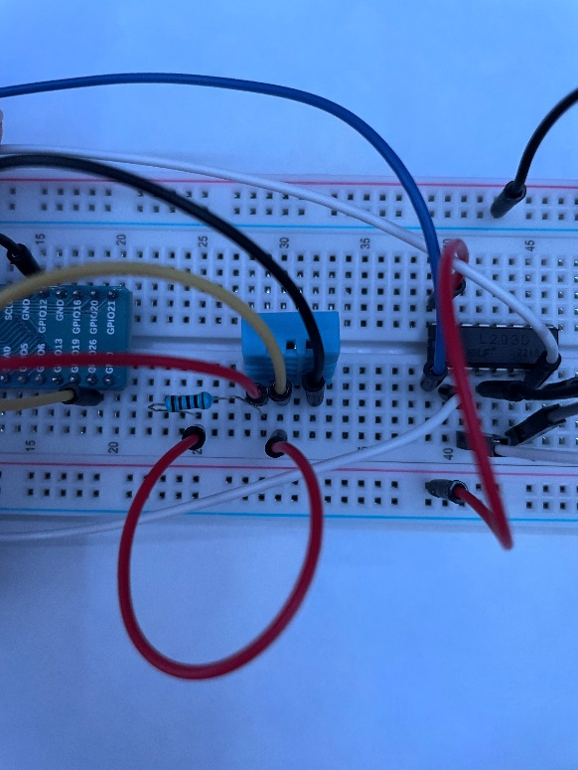
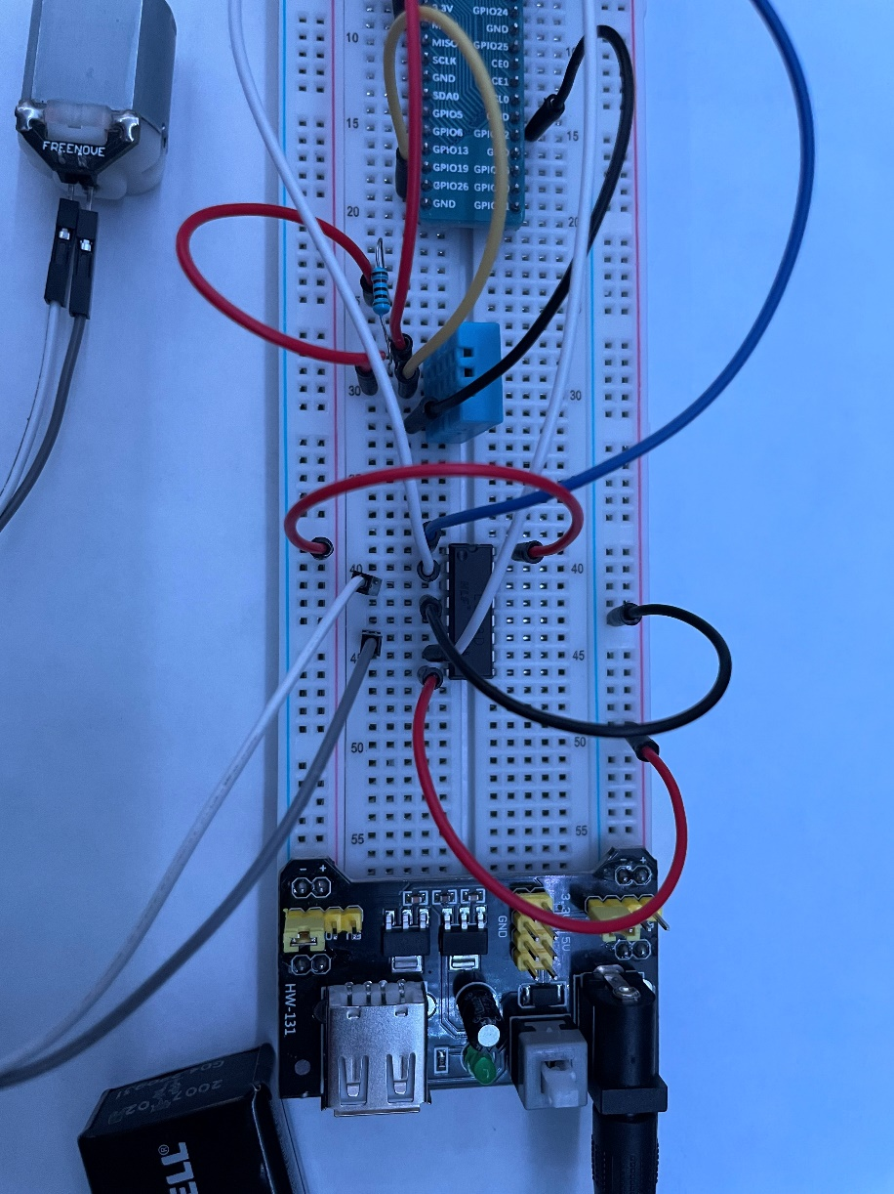
Activities for Phase 2 (Wiring)

Slide 17
Activities for Phase 2 (Components and Libraries)
Components introduced:
Libraries imported:
DHT11 Temperature and Humidity sensor
Resistors (10k Ω)
DC Motor
L293D motor driver
HW-131 for power supply (9v battery)
Wires
dash_daq
Freenove_DHT
smtplib (send emails)
imaplib (access emails)
email (manage email messages)
secrets
string
time

Slide 18
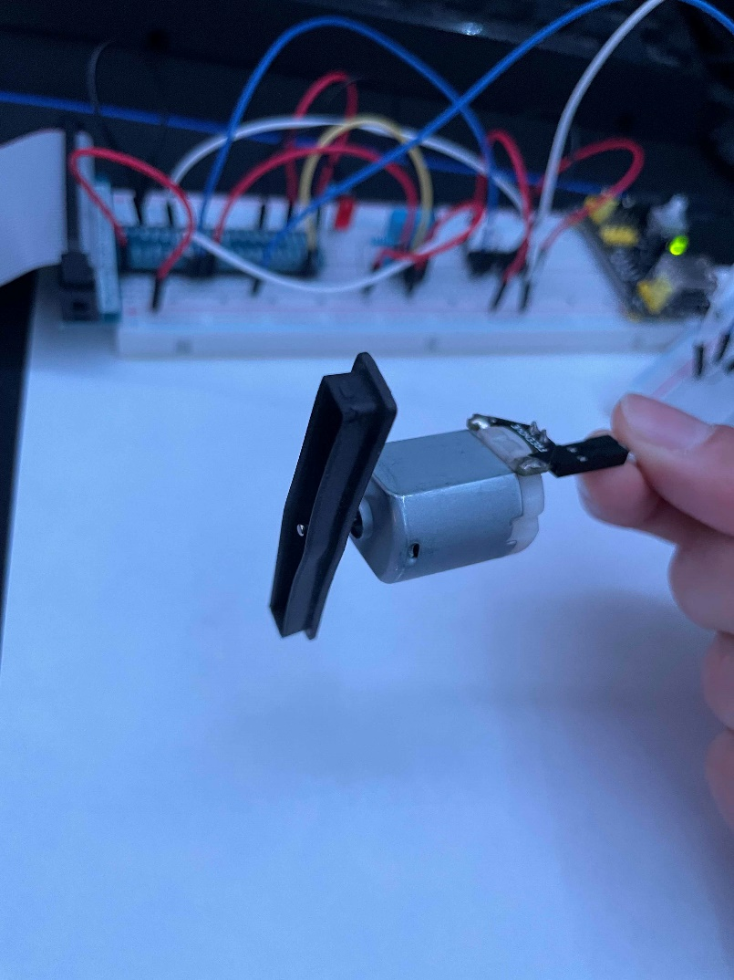
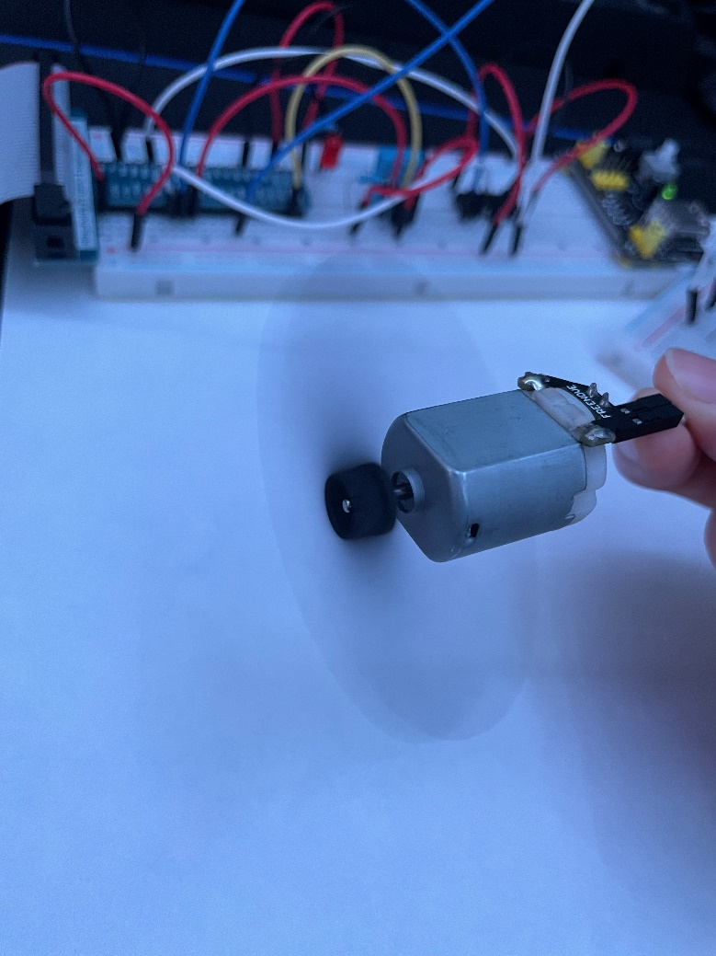
Activities for Phase 2 (Breadboard)
When the temperature surpasses the threshold, the user receives an email. If they reply yes, the motor will turn on making the fan spin.
The fan will only turn off once the temperature goes below the threshold.
Anything other than “yes” will leave the fan off

Slide 19
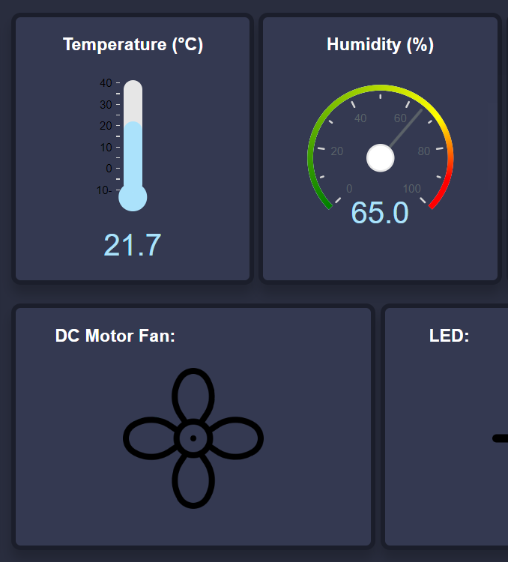
Activities for Phase 2 (Dashboard)
We are using a Dash component called “Interval” which updates the app in real-time without having to reload the page or click any button.
We used this component to read the temperature and humidity from the DHT11 sensor and update the values on the dashboard.

Slide 20
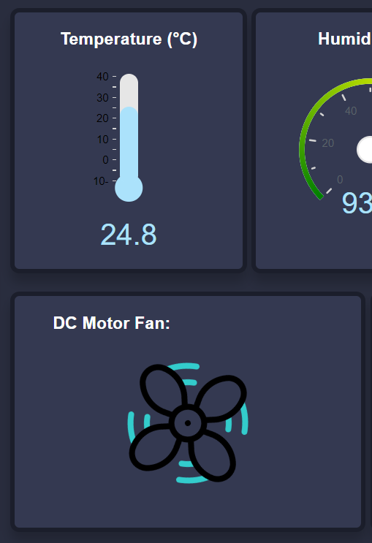
Activities for Phase 2 (Const.) (Dashboard)
When the user allows the system to open the fan, the fan image on the dashboard will start to spin

Slide 21
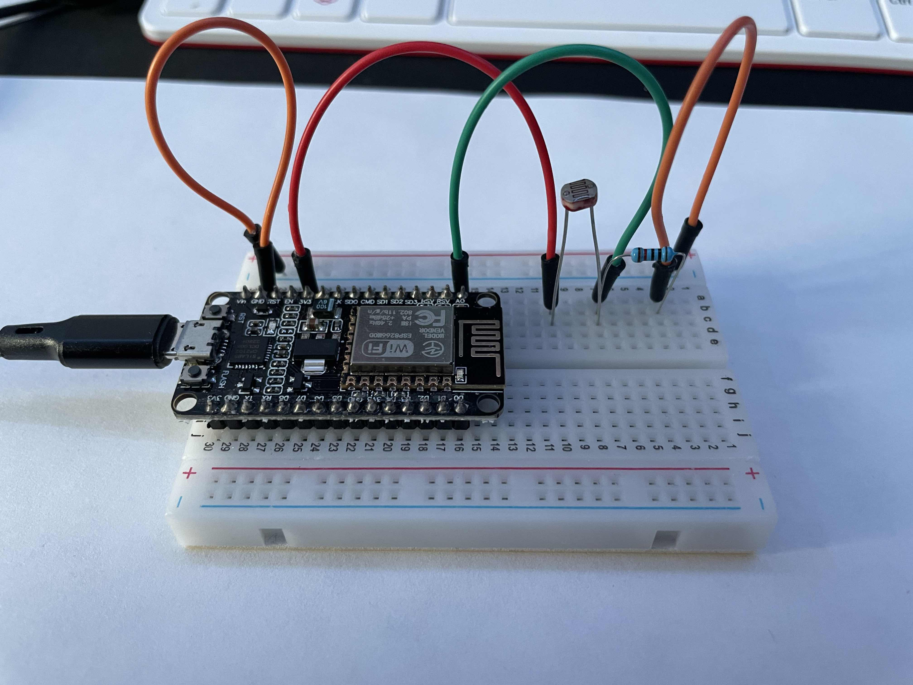
Activities for Phase 3
In Phase 3, we used the ESP8266 and the Photoresistor to capture the light intensity in a room and publish that data to the Broker.
That data is then be used to manipulate an LED depending on the threshold.
We are using the same LED setup from phase 1, but removed the switch that turns it ON and OFF.
Data exchange was done using MQTT publish-subscribe communication

Slide 22
Activities for Phase 3 (Components and Libraries)
Components introduced :
Libraries imported:
LED
Photoresistor
ESP8266
Resistor (10kΩ and 220Ω)
Wires
Python:
paho.mqtt.client
Arduino:
ESP8266WiFi.h
PubSubClient.h
Arduino.h

Slide 23

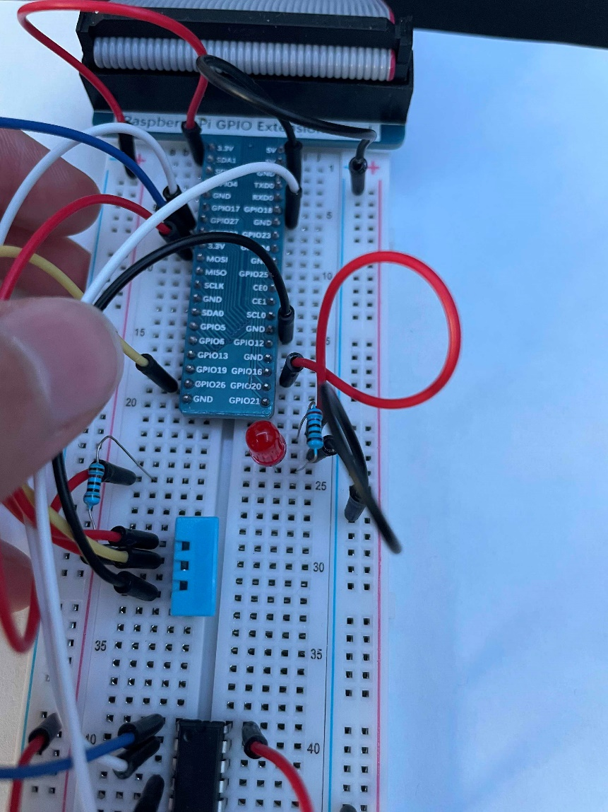
Activities for Phase 3 (Breadboard)
The Photoresistor is connected to the ESP8266 and measures the light intensity in the room. When the light intensity goes under the threshold, the LED will turn on.
The LED will turn off when the light intensity is above the threshold.

Slide 24
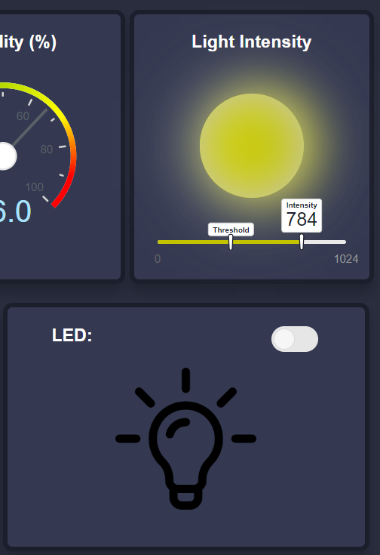
Activities for Phase 3 (Dashboard)
The light intensity value and the threshold are both displayed on the slider.
While the intensity value remains above the threshold, the LED will stay off.
Intensity value is being updated using the “interval” component

Slide 25
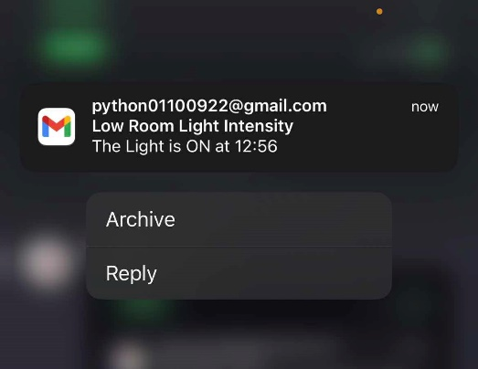
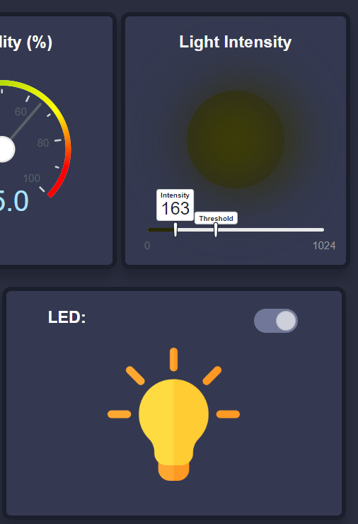
Activities for Phase 3 (Const.) (Dashboard)
When the light intensity goes under the threshold, the icon representing the intensity turns darker and the image representing the LED will change.

Slide 26
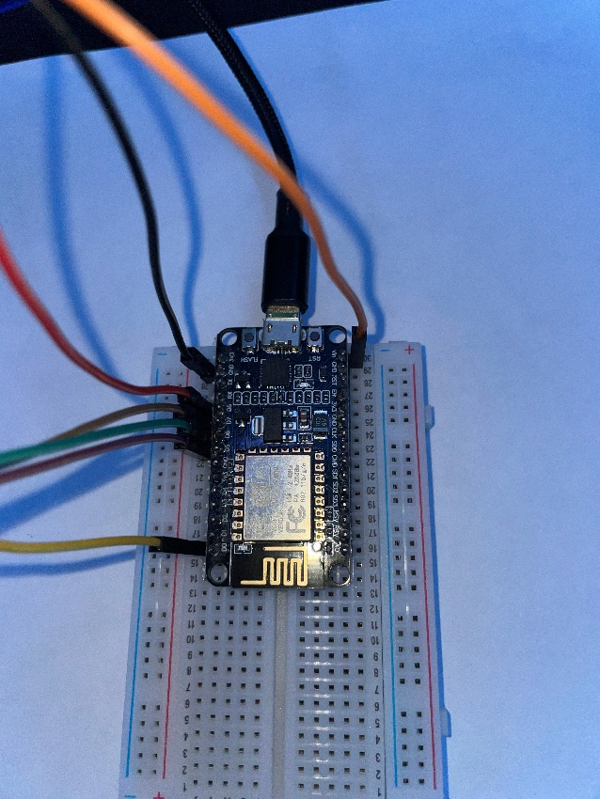
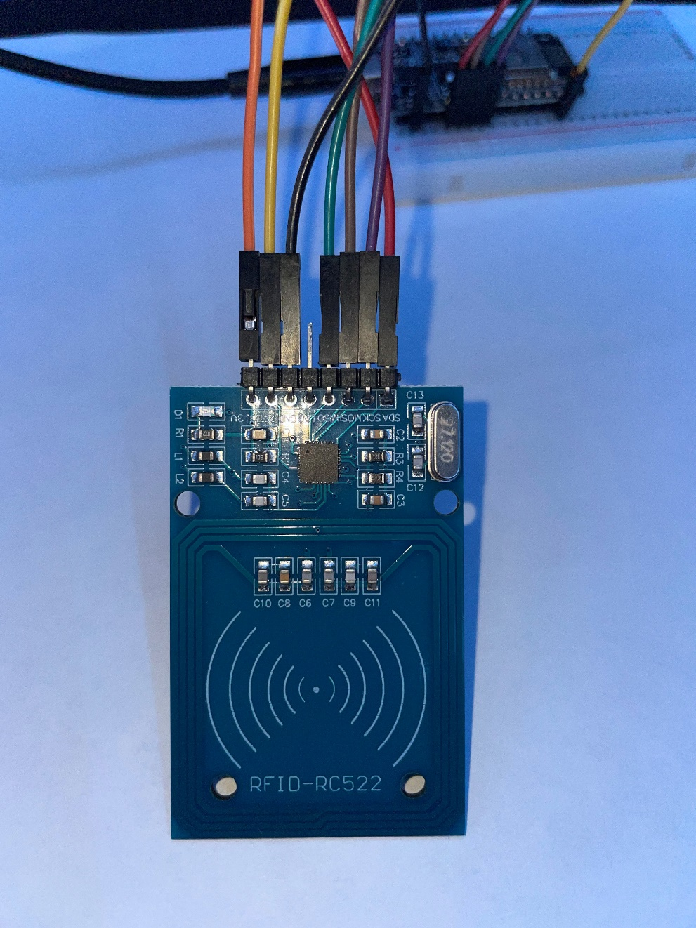
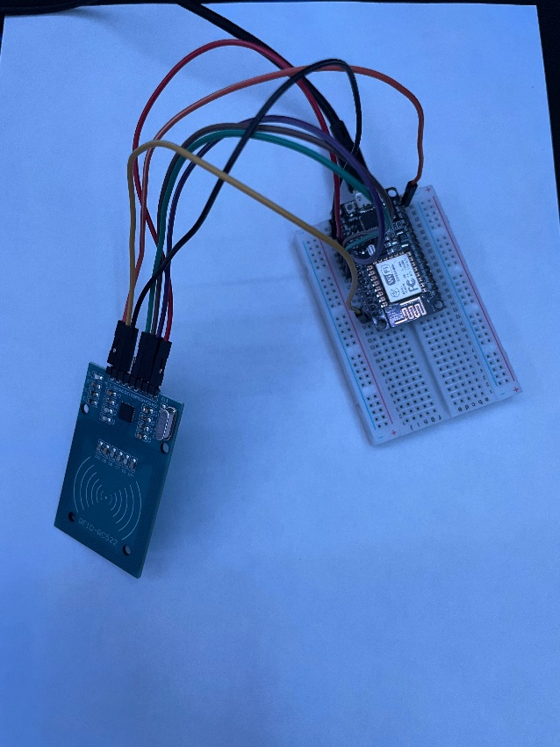
Activities for Phase 4
In Phase 4, we used the RFID reader to capture the tag’s ID and update the user's information on the dashboard.
The User’s information will be stored in a database (SQLite)
Data exchange between the application and the ESP8266 is done through the MQTT publish-subscribe communication protocol

Slide 27
Activities for Phase 4 (Components and Libraries)
Components introduced :
Libraries imported:
RC522 RFID Module
ESP8266
RFID Tags
Wires
Python:
SQLite3
Arduino:
SPI.h
MFRC522.h

Slide 28

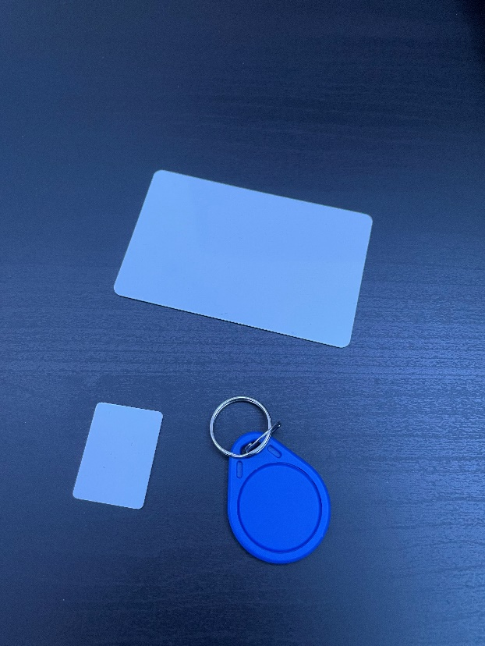
Activities for Phase 4 (Breadboard)
The values of the RFID Tags are being read by an RFID reader that’s connected to the ESP8266.
The data is sent to the application through the ESP8266 using the MQTT protocol.

Slide 29
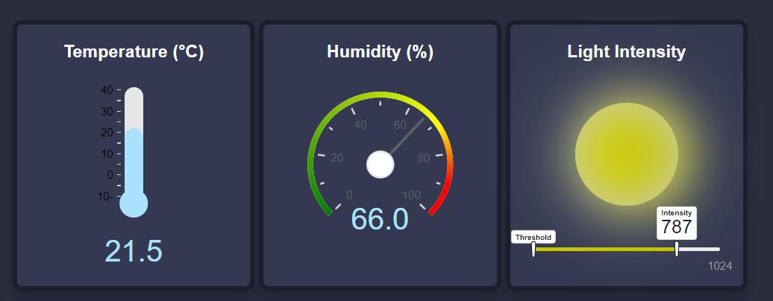
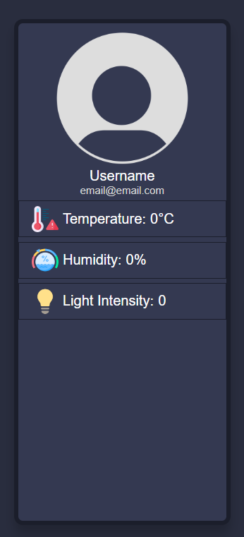
Activities for Phase 4 (Dashboard)
When no RFID tag has been tapped on the RFID reader yet, the information on the application will be set to default.
Furthermore, when a tag that does not exist in the database is tapped, the information on the application will be set back to default.

Slide 30
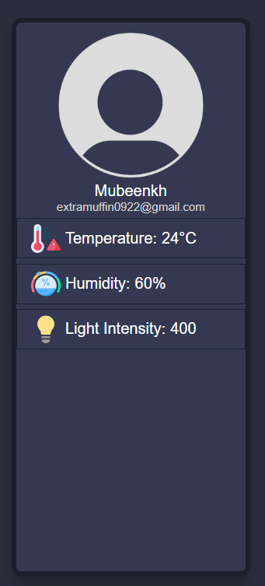
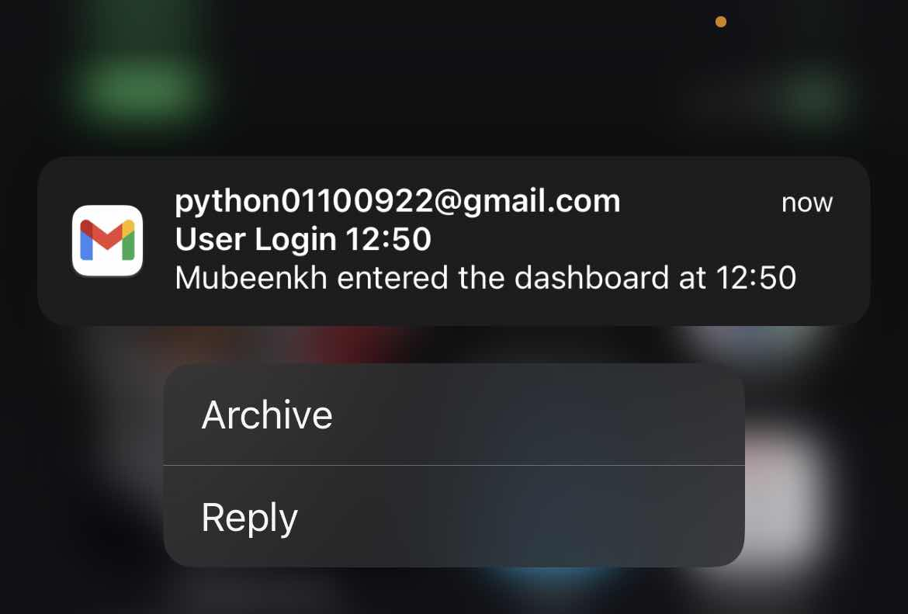
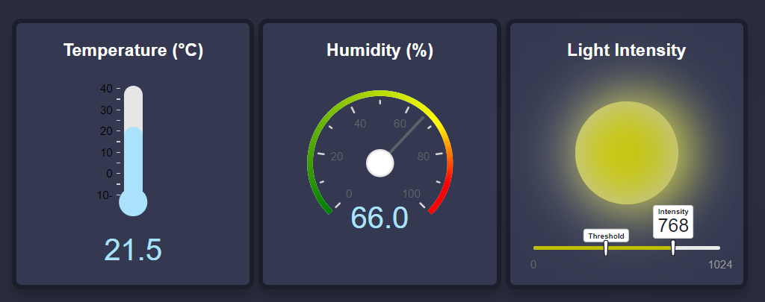
Activities for Phase 4 (Const.) (Dashboard)
After tapping a tag that is in the database, the information of that user will be displayed in the dashboard.
Furthermore, an email will be sent to the user letting them know what time they have accessed the dashboard.

Slide 31
Challenges and achievements (Conclusion)
We had a lot of trouble trying to implement the Bluetooth feature, since the libraries we needed were not installing. Furthermore, the Bluetooth feature wasn’t completed according to phase 4 requirement, so we did not include it in the dashboard.
The RFID reader would not work most of the time. At first, it did not read any information from the tags. Then, it would read the data from the tags on the Arduino IDE, but nothing would be received or update on the application.

Slide 32

Thank You

